Slide 1

PulseMax
Dec 16, 2025 - Jan 14, 2026
Prepared For:
Choctaw - Together We're More

Slide 2

Overview

Slide 3

Video Ads - Overall Performance
Video - Top KPIs
Impressions
75.1K
Video Completes
62.2K
VCR(%)
82.77%
Clicks
1
CTR(%)
0.00%
Video - Product Performance
Product | Impressions | Video Completes | VCR(%) | Clicks | CTR(%)
YouTube True View | 75,115 | 62,171 | 82.77 | 1 | 0
12/16/2025-01/14/2026

Slide 4
STV Ads - Overall Performance
STV - Top KPIs
Impressions
365.5K
Video Completes
116.7K
VCR(%)
97.14%
Clicks
173
Total Conversions
0
STV - Product Performance
Product | Impressions | Video Completes | VCR(%) | Total Conversions
STV | 245,333 | 0 | - | 0
Targeted STV | 120,195 | 116,688 | 97.14 | 0
12/16/2025-01/14/2026

Slide 5
SEM Ads - Overall Performance
Search Engine Marketing
Impressions
946
Clicks
51
CTR(%)
5
Primary Conversions
0
Primary Conv. Rate
-
All Conversions
0
All Conv. Rate
-
12/16/2025-01/14/2026

Slide 6
S.E.M (Search)

Slide 7
Search Engine Marketing (SEM) Overview
Key Performance Indicator
Impressions
946
Clicks
51
CTR(%)
5.39%
Conversion Event
Primary Conversions
0
All Conversions
0
12/16/2025-01/14/2026

Slide 8
Search Engine Marketing (SEM) Overview
Monthly Performance
Date | Impressions | Clicks | CTR(%) | Primary Conversions | Primary Conversions Rate | All Conversions | All Conversions Rate
01-2026 | 946 | 51 | 5.39 | 0 | - | 0 | -
12/16/2025-01/14/2026

Slide 9
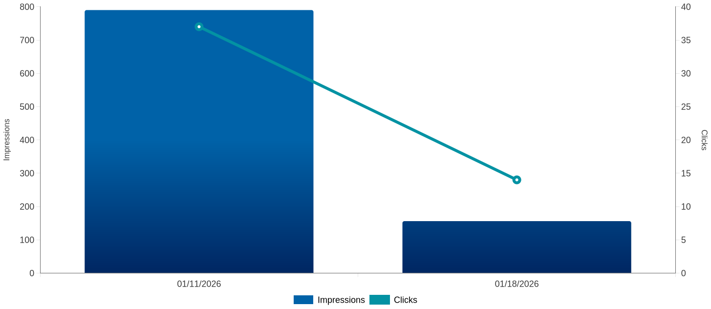
Search Engine Marketing (SEM) Overview
Weekly Performance Trend(s)
12/16/2025-01/14/2026

Slide 10
Platform Performance
Platform Performance
Data Source Name | Impressions | Clicks | CTR(%) | Primary Conversions | Primary Conversions Rate | All Conversions | All Conversions Rate
googleads | 946 | 51 | 5.39 | 0 | - | 0 | -
12/16/2025-01/14/2026

Slide 11
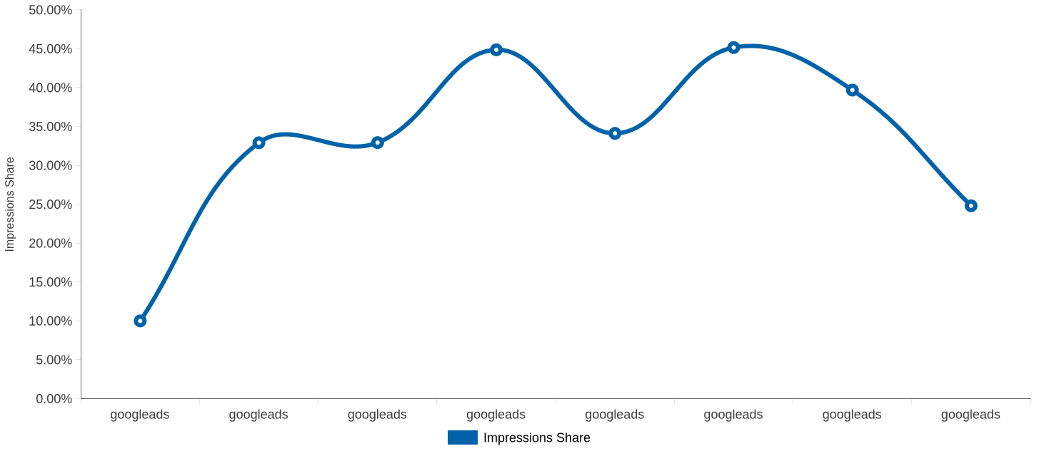
Platform Performance
Google - Avg Daily Search Impression Share
12/16/2025-01/14/2026

Slide 12
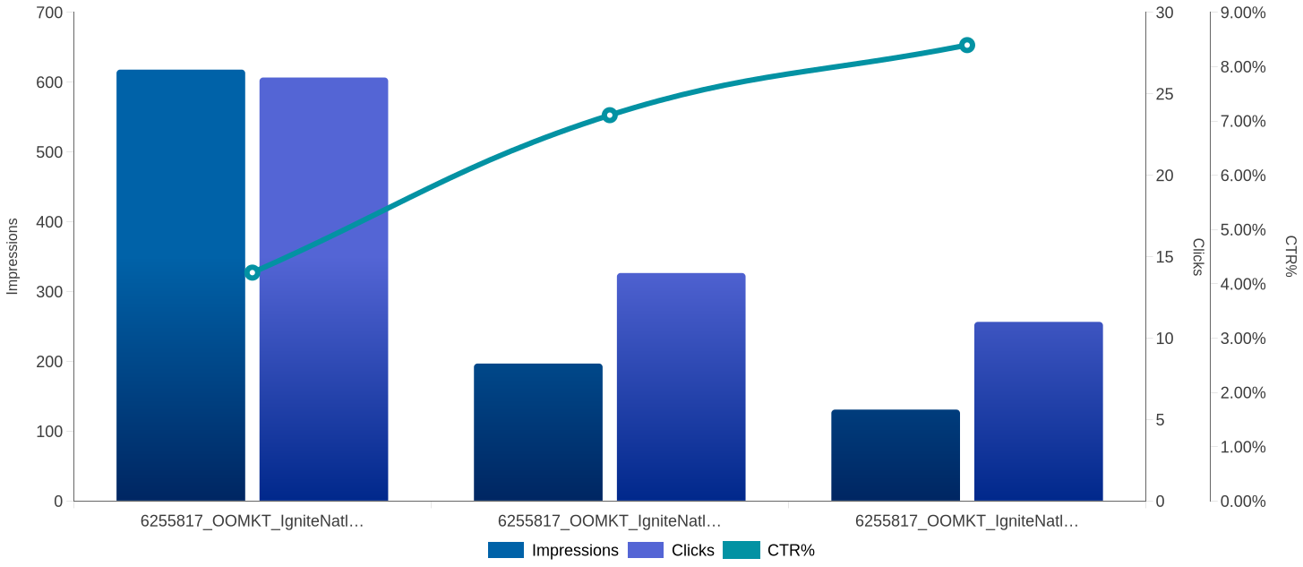
Campaign Performance
Campaign Performance
12/16/2025-01/14/2026

Slide 13
Campaign Performance
Campaign Performance
Campaign Name | Impressions | Clicks | Primary Conversions | Primary Conversions Rate | All Conversions | All Conversions Rate
6255817_OOMKT_IgniteNatl_Choctaw - Together We're More_OKC & Norman_SEM-SEARCH | 618 | 26 | 0 | - | 0 | -
6255817_OOMKT_IgniteNatl_Choctaw - Together We're More_Tulsa_SEM-SEARCH | 197 | 14 | 0 | - | 0 | -
6255817_OOMKT_IgniteNatl_Choctaw - Together We're More_Ada & Ardmore_SEM-SEARCH | 131 | 11 | 0 | - | 0 | -
12/16/2025-01/14/2026

Slide 14
Ad Group and Client Performance
Client Performance
Client | Impressions | Clicks | CTR(%) | Primary Conversions | All Conversions
Choctaw - Together We're More | 946 | 51 | 5.39 | 0 | 0
12/16/2025-01/14/2026

Slide 15
Ad Group and Client Performance
Ad Group Performance
Ad Group | Impressions | Clicks | CTR(%) | Primary Conversions | All Conversions
6255817_OOMKT_IgniteNatl_Choctaw - Together We're More_OKC & Norman_SEM-SEARCH_Choctaw | 364 | 16 | 4.4 | 0 | 0
6255817_OOMKT_IgniteNatl_Choctaw - Together We're More_Ada & Ardmore_SEM-SEARCH_Choctaw | 122 | 11 | 9.02 | 0 | 0
6255817_OOMKT_IgniteNatl_Choctaw - Together We're More_Tulsa_SEM-SEARCH_Choctaw | 73 | 6 | 8.22 | 0 | 0
6255817_OOMKT_IgniteNatl_Choctaw - Together We're More_Tulsa_SEM-SEARCH_History | 98 | 6 | 6.12 | 0 | 0
6255817_OOMKT_IgniteNatl_Choctaw - Together We're More_OKC & Norman_SEM-SEARCH_History | 109 | 5 | 4.59 | 0 | 0
12/16/2025-01/14/2026

Slide 16
Keyword Performance
Top 10 Keywords (Impressions)
Keyword | Impressions
Choctaw Nation | 399
native history oklahoma | 129
first americans museum | 66
choctaw cultural center | 41
choctaw indian tribe | 41
Choctaw Nation Community | 31
american indian tribes history | 27
native american tribes | 22
native indian american history | 17
real history of native americans | 16
12/16/2025-01/14/2026

Slide 17
Keyword Performance
Top 10 Keywords (Clicks)
Keyword | Clicks | CPC($)
Choctaw Nation | 24 | $11.68
native history oklahoma | 7 | $10.00
choctaw cultural center | 4 | $9.06
first americans museum | 3 | $7.07
Choctaw Nation Community | 3 | $12.83
native indian american history | 2 | $5.22
american indian tribes history | 1 | $5.03
choctaw indian tribe | 1 | $7.78
real history of native americans | 1 | $5.03
all native american reservations | 1 | $6.02
12/16/2025-01/14/2026

Slide 18
Keyword Performance
Top 10 Keywords (Conversions)
Keyword | Primary Conversions
real history of native americans | 0
native american tribes | 0
Choctaw Nation School | 0
Choctaw Nation Community | 0
native history oklahoma | 0
native american people today | 0
Choctaw Stickball | 0
old native american artifacts | 0
all native american languages | 0
Choctaw Artists | 0
12/16/2025-01/14/2026

Slide 19
Keyword Performance
Overall Keyword Performance
Keyword | Impressions | Clicks | CTR(%) | Primary Conversions | Primary Conversions Rate | All Conversions | All Conversions Rate
Choctaw Nation | 399 | 24 | 6.02 | 0 | - | 0 | -
native history oklahoma | 129 | 7 | 5.43 | 0 | - | 0 | -
choctaw cultural center | 41 | 4 | 9.76 | 0 | - | 0 | -
first americans museum | 66 | 3 | 4.55 | 0 | - | 0 | -
Choctaw Nation Community | 31 | 3 | 9.68 | 0 | - | 0 | -
12/16/2025-01/14/2026

Slide 20
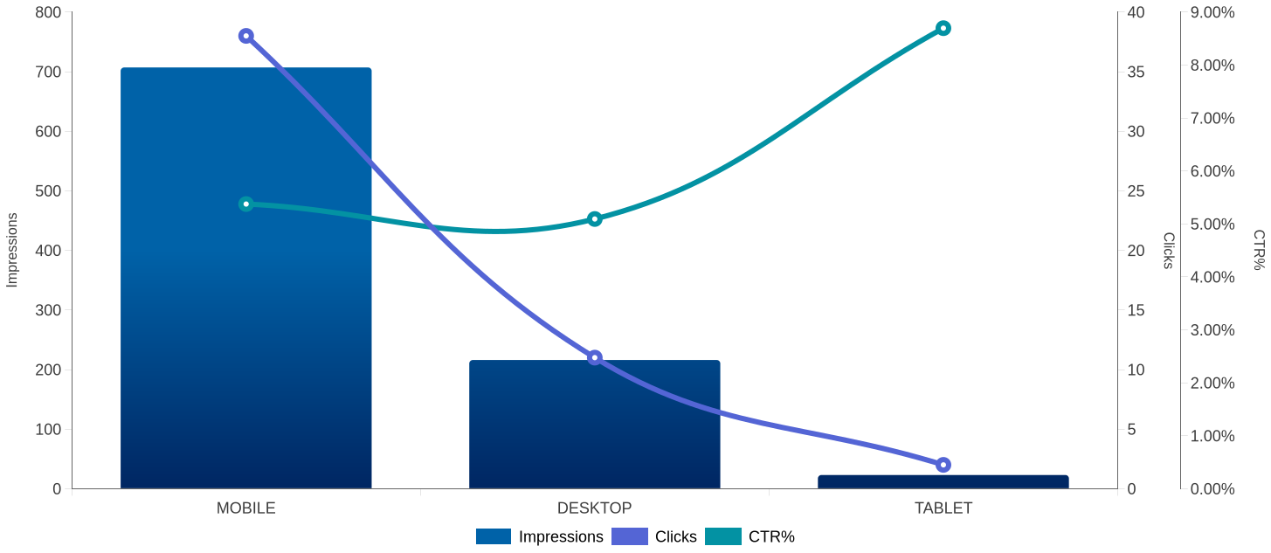
Device Performance
Performance Trends By Device Type
12/16/2025-01/14/2026

Slide 21
Device Performance
Device Performance
Device | Impressions | Clicks | CTR(%) | Primary Conversions | All Conversions
MOBILE | 707 | 38 | 5.37 | 0 | 0
DESKTOP | 216 | 11 | 5.09 | 0 | 0
TABLET | 23 | 2 | 8.7 | 0 | 0
12/16/2025-01/14/2026

Slide 22
Geo Performance
Performance by City
Performance by Zip
State | City | Impressions | Clicks | CTR(%)
Oklahoma | Tulsa | 158 | 13 | 8.23
Oklahoma | Oklahoma City | 232 | 9 | 3.88
Oklahoma | Ada | 81 | 9 | 11.11
Oklahoma | Norman | 99 | 5 | 5.05
Oklahoma | Ardmore | 50 | 2 | 4
State | Zip Code | Impressions | Clicks | CTR(%)
Oklahoma | 74820 | 81 | 9 | 11.11
Oklahoma | 73069 | 35 | 4 | 11.43
Oklahoma | 73160 | 20 | 2 | 10
Oklahoma | 73129 | 14 | 2 | 14.29
Oklahoma | 73159 | 8 | 2 | 25
12/16/2025-01/14/2026

Slide 23
Streaming TV

Slide 24
Streaming TV (STV/CTV) Overview
Key Performance Indicator
Impressions
120.2K
Video Starts(s)
120.1K
100 Complete(s)
116.7K
VCR(%)
97.14%
Reach
8535
Frequency
14.08
Monthly Performance
Date | Impressions | Video Starts | 25% Complete | 50% Complete | 75% Complete | 100% Completes | VCR(%)
01-2026 | 120,195 | 120,122 | 118,486 | 117,921 | 117,237 | 116,688 | 97.14
12/16/2025-01/14/2026

Slide 25
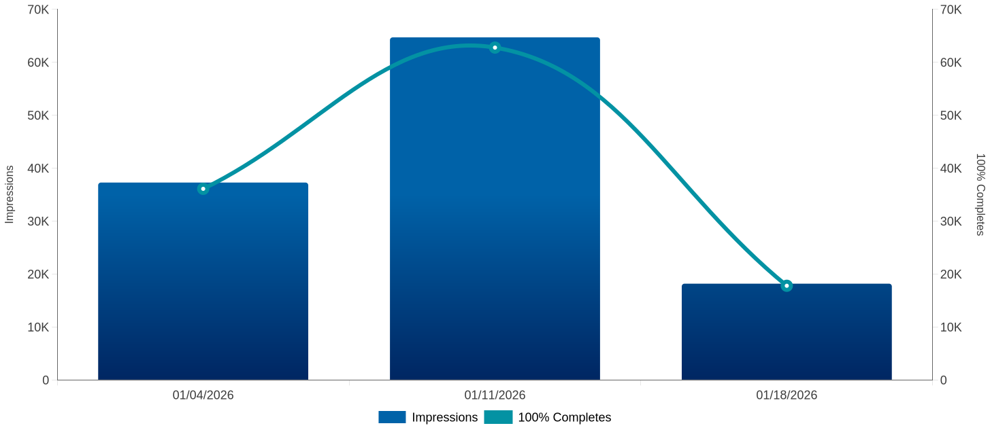
Streaming TV (STV/CTV) Overview
Weekly Performance Trend(s)
12/16/2025-01/14/2026

Slide 26
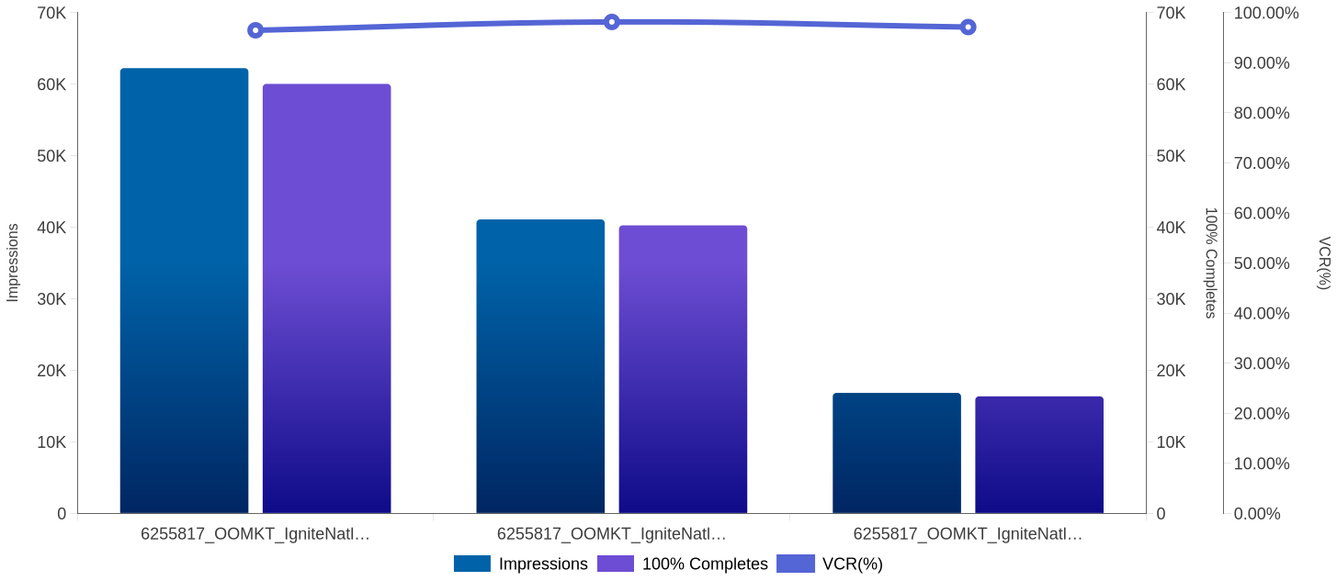
Campaign Performance
Campaign Performance
12/16/2025-01/14/2026

Slide 27
Campaign Performance
Campaign Performance
Campaign Name | Impressions | Video Starts | 25% Complete | 50% Complete | 75% Complete | 100% Completes | VCR(%)
6255817_OOMKT_IgniteNatl_Choctaw - Together We're More_OKC & Norman_AAT-STV | 62,243 | 62,237 | 61,082 | 60,717 | 60,408 | 60,046 | 96.48
6255817_OOMKT_IgniteNatl_Choctaw - Together We're More_Ada & Ardmore_AAT-STV | 41,098 | 41,031 | 40,645 | 40,514 | 40,396 | 40,272 | 98.15
6255817_OOMKT_IgniteNatl_Choctaw - Together We're More_Tulsa_AAT-STV | 16,854 | 16,854 | 16,759 | 16,690 | 16,433 | 16,370 | 97.13
12/16/2025-01/14/2026

Slide 28
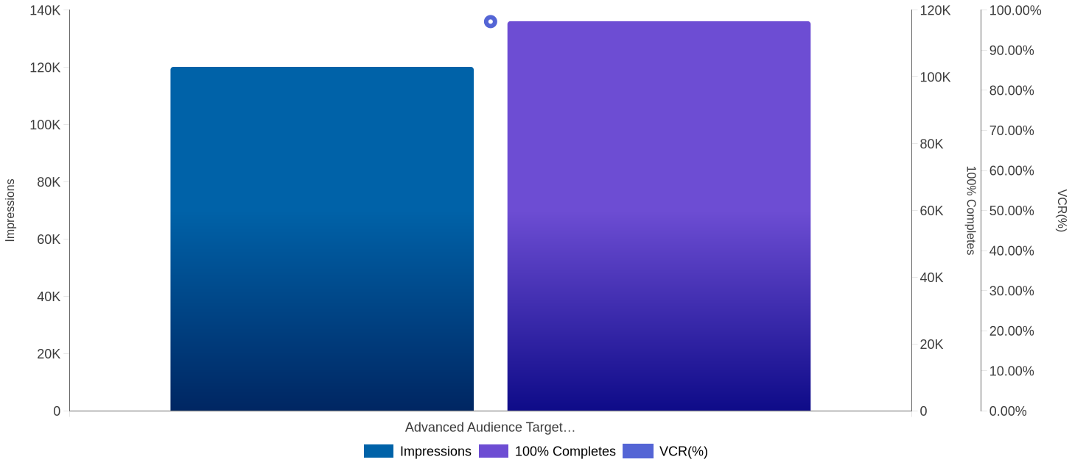
Tactic Performance
Tactic Performance Trends
12/16/2025-01/14/2026

Slide 29
Tactic Performance
Tactic Performance
Tactic | Impressions | 100% Completes | VCR(%)
Advanced Audience Targeting | 120,195 | 116,688 | 97.14
12/16/2025-01/14/2026

Slide 30
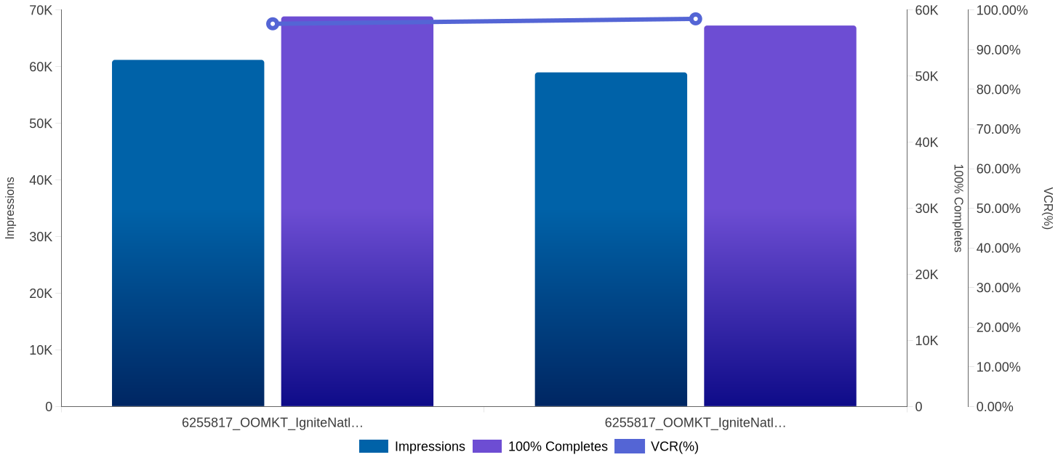
Creative Performance
Creative Performance
12/16/2025-01/14/2026

Slide 31
Creative Performance
Creative Performance
Creative | Impressions | 25% Complete | 50% Complete | 75% Complete | 100% Completes | VCR(%)
6255817_OOMKT_IgniteNatl_Choctaw - Together We're More_Video_Charles Shadle ORGANIC | 61,202 | 59,946 | 59,665 | 59,325 | 59,034 | 96.53
6255817_OOMKT_IgniteNatl_Choctaw - Together We're More_Video_Charles Shadle PAID | 58,993 | 58,540 | 58,256 | 57,912 | 57,654 | 97.78
12/16/2025-01/14/2026

Slide 32
Geo Performance
Performance by City
Performance by Zip
DMA/City | Impressions | 100% Completes | VCR(%)
Oklahoma City | 38,144 | 36,920 | 96.8
Sherman, TX - Ada, OK | 25,016 | 24,564 | 98.45
Oklahoma City | 24,099 | 23,126 | 95.97
Sherman, TX - Ada, OK | 16,082 | 15,708 | 97.69
Tulsa | 10,542 | 10,204 | 96.79
Postal Code | Impressions | 100% Completes | VCR(%)
73401 | 14,412 | 14,161 | 98.61
73071 | 11,157 | 10,863 | 97.37
74820 | 10,528 | 10,344 | 98.37
73072 | 9,075 | 8,798 | 96.96
73401 | 9,001 | 8,798 | 97.78
12/16/2025-01/14/2026

Slide 33
Publisher Performance
Publisher Performance
Site/Publisher/Domain | Impressions | 100% Completes | VCR(%)
Samsung TV Plus | 23,841 | 23,236 | 97.47
Pluto | 9,512 | 9,348 | 98.4
Paramount Network | 6,922 | 6,777 | 98.25
Paramount Streaming | 6,686 | 6,507 | 97.42
VIZIO WatchFree+ | 4,785 | 4,733 | 98.91
12/16/2025-01/14/2026

Slide 34
YouTube

Slide 35
Youtube Overview
Key Performance Indicator
Key Performance Indicator
Impressions
75.1K
100% Completion
62.2K
VCR(%)
82.77%
Interactions
63K
All Conv.
67
Monthly Performance
Date | Impressions | 25% Complete | 50% Complete | 75% Complete | 100% Completes | VCR(%) | Clicks | All Conv. | Interactions
01-2026 | 75,115 | 74,172 | 71,750 | 65,625 | 62,171 | 82.77 | 1 | 67 | 63,013
12/16/2025-01/14/2026

Slide 36
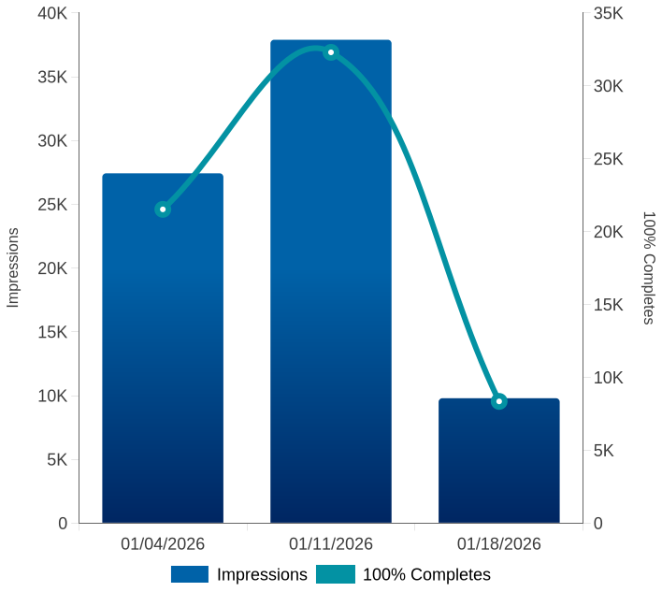
Youtube Overview
Conversion Type
Weekly Performance Trend(s)
Conversion Action Name | All Conv.
UNKNOWN | 67
12/16/2025-01/14/2026

Slide 37
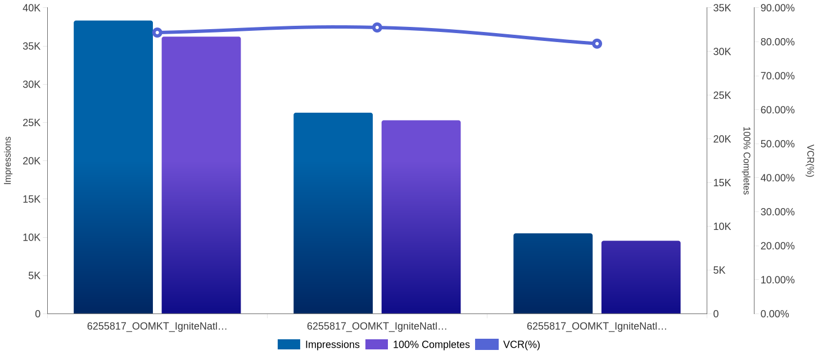
Campaign Performance
Campaign Performance Trends
12/16/2025-01/14/2026

Slide 38
Campaign Performance
Campaign Performance
Campaign Name | Impressions | 25% Complete | 50% Complete | 75% Complete | 100% Completes | VCR(%) | Clicks | All Conv. | Interactions
6255817_OOMKT_IgniteNatl_Choctaw - Together We're More_OKC & Norman_CPV | 38,327 | 37,925 | 36,796 | 33,606 | 31,696 | 82.7 | 1 | 39 | 32,177
6255817_OOMKT_IgniteNatl_Choctaw - Together We're More_Ada & Ardmore_CPV | 26,282 | 25,950 | 25,141 | 23,190 | 22,129 | 84.2 | 0 | 15 | 22,274
6255817_OOMKT_IgniteNatl_Choctaw - Together We're More_Tulsa_CPV | 10,506 | 10,297 | 9,813 | 8,829 | 8,346 | 79.44 | 0 | 13 | 8,562
12/16/2025-01/14/2026

Slide 39
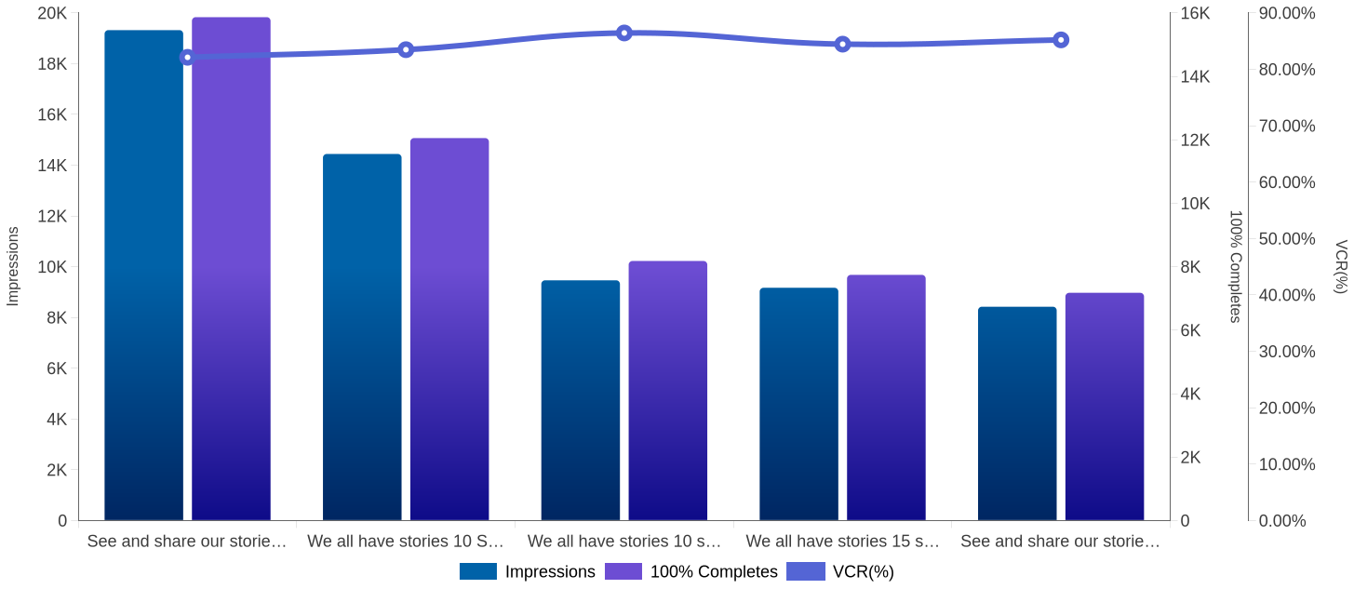
Creative Performance
Creative Performance
12/16/2025-01/14/2026

Slide 40
Creative Performance
Creative Performance
Ad Name | Impressions | 25% Complete | 50% Complete | 75% Complete | 100% Completes | VCR(%) | Clicks | All Conv. | Interactions
See and share our stories 10 sec | 19,319 | 19,189 | 19,097 | 17,047 | 15,864 | 82.12 | 0 | 15 | 15,809
We all have stories 10 Sec | 14,440 | 14,372 | 14,324 | 12,940 | 12,053 | 83.47 | 1 | 11 | 12,043
We all have stories 10 sec | 9,463 | 9,423 | 9,391 | 8,632 | 8,179 | 86.43 | 0 | 5 | 8,112
We all have stories 15 sec | 9,168 | 9,113 | 8,325 | 7,913 | 7,742 | 84.45 | 0 | 7 | 7,966
See and share our stories 15 sec | 8,422 | 8,369 | 7,724 | 7,366 | 7,176 | 85.21 | 0 | 8 | 7,418
12/16/2025-01/14/2026

Slide 41
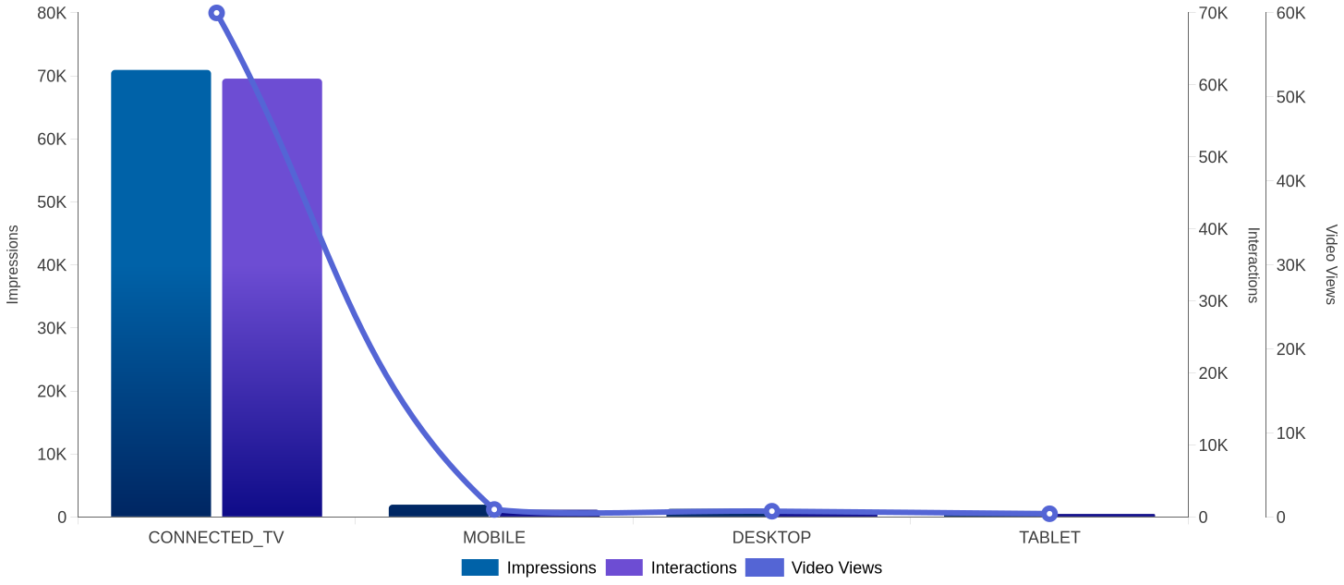
Device Performance
Performance Trends By Device Type
12/16/2025-01/14/2026

Slide 42
Device Performance
Device Performance
Device | Impressions | Video Views | VCR(%) | Clicks | Interactions
CONNECTED_TV | 70,924 | 59,982 | 84.87 | 0 | 60,853
MOBILE | 1,953 | 891 | 46.03 | 1 | 1,012
DESKTOP | 1,286 | 686 | 54.35 | 0 | 727
TABLET | 951 | 385 | 40.48 | 0 | 419
12/16/2025-01/14/2026

Slide 43
Geo Performance
Geo Performance - City
Region(User location) | City(User location) | Impressions | Video Views | Clicks | Interactions
Oklahoma | Norman | 22,235 | 18,637 | 1 | 18,892
Oklahoma | Oklahoma City | 16,091 | 13,042 | 0 | 13,284
Oklahoma | Ardmore | 14,278 | 11,855 | 0 | 12,034
Oklahoma | Ada | 11,870 | 9,967 | 0 | 10,114
Oklahoma | Tulsa | 10,506 | 8,321 | 0 | 8,562
12/16/2025-01/14/2026

Slide 44
Geo Performance
Geo Performance - Metro Area
Postal Code(User location) | Region(User location) | Impressions | Video Views | Clicks | Interactions
73401 | Oklahoma | 14,278 | 11,855 | 0 | 12,034
74820 | Oklahoma | 11,870 | 9,967 | 0 | 10,114
73072 | Oklahoma | 9,017 | 7,772 | 0 | 7,855
73071 | Oklahoma | 7,397 | 6,074 | 1 | 6,169
73129 | Oklahoma | 6,432 | 5,125 | 0 | 5,235
12/16/2025-01/14/2026

Slide 45
Demographic Performance
Performance by Gender Clicks
12/16/2025-01/14/2026

Slide 46
Demographic Performance
Performance by Age Group
Age Range | Impressions | Video Views | Clicks | Interactions
65+ | 20,814 | 18,558 | 0 | 18,741
55-64 | 11,223 | 9,788 | 1 | 9,905
25-34 | 10,150 | 8,008 | 0 | 8,191
45-54 | 8,341 | 7,006 | 0 | 7,113
18-24 | 8,843 | 6,899 | 0 | 7,036
12/16/2025-01/14/2026

Slide 47
Creative Placement Performance
Placements - Top 10
Placement Display Name | Impressions | Video Views | Clicks | CTR(%)
(YouTube TV) FOX News | 10,964 | 10,877 | 0 | -
(YouTube TV) MS NOW | 3,426 | 3,390 | 0 | -
YouTube Movies | 3,621 | 3,248 | 0 | -
(YouTube TV) CNN | 2,457 | 2,443 | 0 | -
(YouTube TV) TV Land | 605 | 585 | 0 | -
12/16/2025-01/14/2026

Slide 48
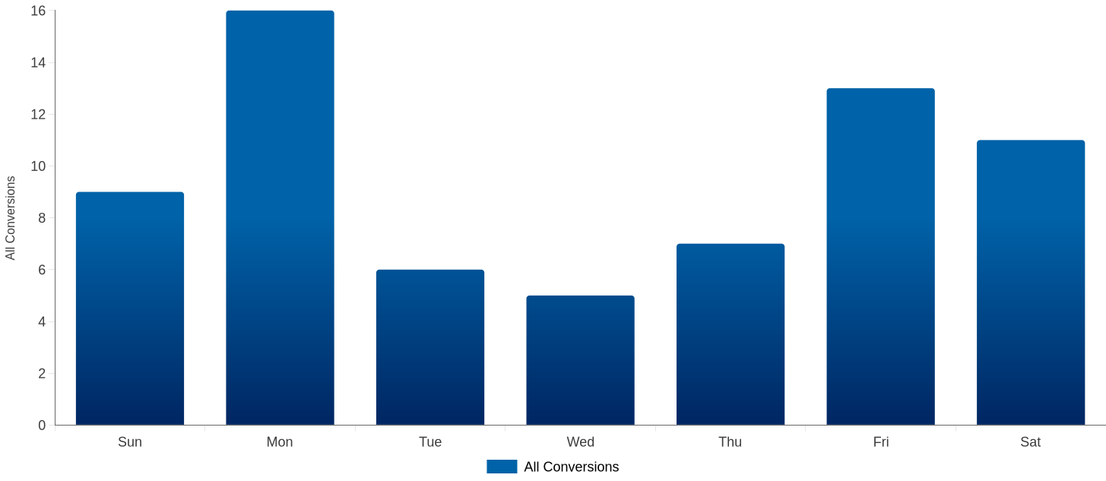
Conversion Attribution
Conversion by Day
12/16/2025-01/14/2026

Slide 49
YouTube TV

Slide 50
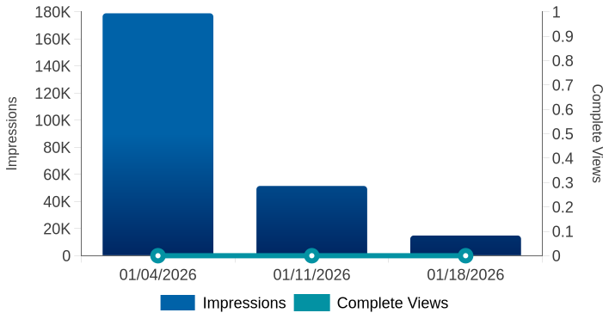
Youtube TV Overview
Key Performance Indicator
Impressions
245.3K
Video Starts
0
Complete Views
0
Completion Rate (Video)
-
Monthly Performance
Weekly Performance Trend(s)
Date | Impressions | Video Starts | Complete Views | Completion Rate (Video)
01-2026 | 245,333 | 0 | 0 | -
12/16/2025-01/14/2026

Slide 51
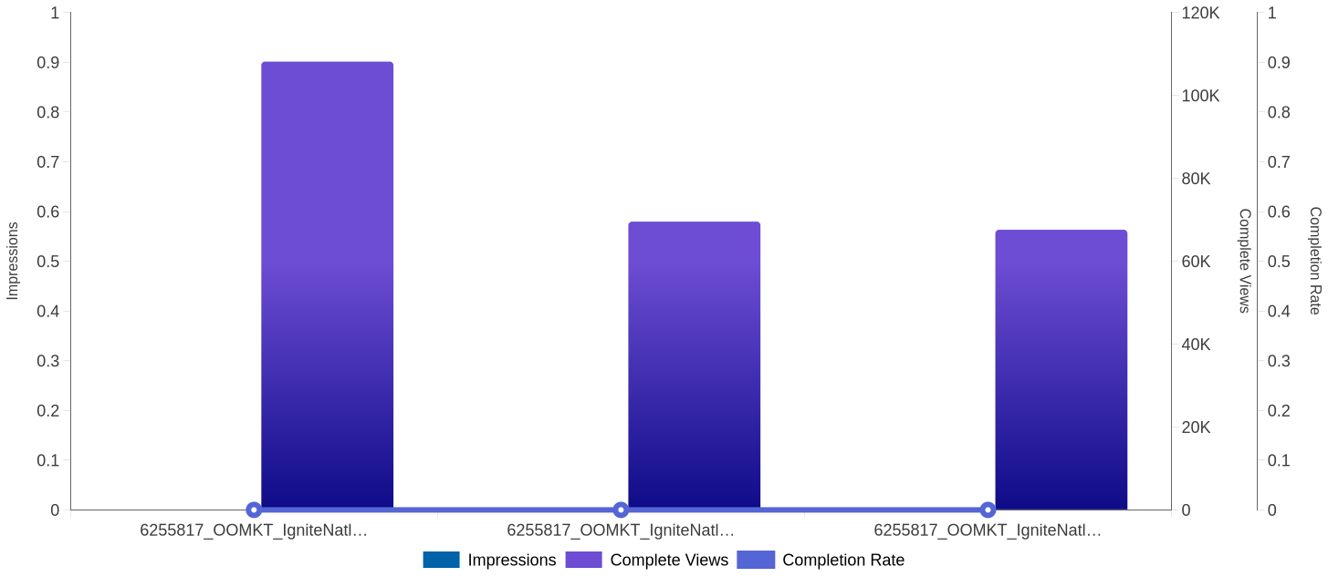
Campaign Performance
Campaign Performance
12/16/2025-01/14/2026

Slide 52
Campaign Performance
Campaign Performance
Campaign Name | Impressions | Video Starts | Complete Views | Completion Rate (Video)
6255817_OOMKT_IgniteNatl_Choctaw - Together We're More_OKC & Norman | 108,174 | 0 | 0 | -
6255817_OOMKT_IgniteNatl_Choctaw - Together We're More_Ada & Ardmore | 69,562 | 0 | 0 | -
6255817_OOMKT_IgniteNatl_Choctaw - Together We're More_Tulsa | 67,597 | 0 | 0 | -
12/16/2025-01/14/2026

Slide 53
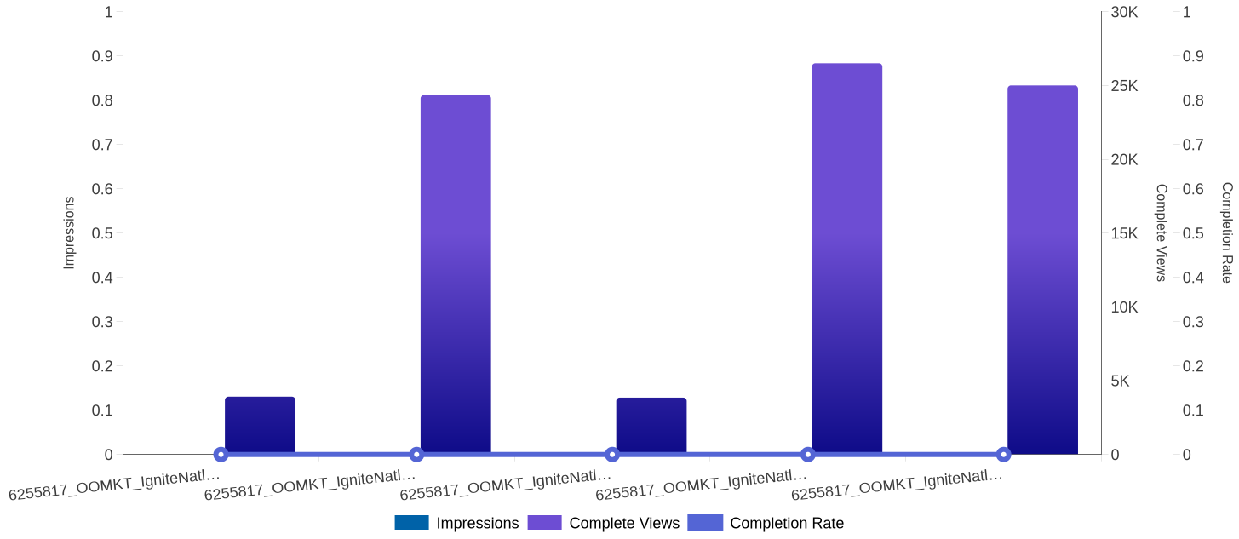
Creative Performance
Creative Performance
12/16/2025-01/14/2026

Slide 54
Creative Performance
Creative Performance
Creative | Impressions | Video Starts | First-Quartile Views | Midpoint Views | Third-Quartile Views | Complete Views | Completion Rate (Video)
6255817_OOMKT_IgniteNatl_Choctaw - Together We're More_300x600_Charles Shadle-Ada & Ardmore | 3,918 | 0 | 0 | 0 | 0 | 0 | -
6255817_OOMKT_IgniteNatl_Choctaw - Together We're More_320x50_Charles Shadle | 24,358 | 0 | 0 | 0 | 0 | 0 | -
 | 3,853 | 0 | 0 | 0 | 0 | 0 | -
12/16/2025-01/14/2026

Slide 55
6255817_OOMKT_IgniteNatl_Choctaw - Together We're More_160x600_Charles Shadle-OKC & Norman
6255817_OOMKT_IgniteNatl_Choctaw - Together We're More_320x50_Charles Shadle-Ada & Ardmore | 26,508 | 0 | 0 | 0 | 0 | 0 | -
6255817_OOMKT_IgniteNatl_Choctaw - Together We're More_300x250_Charles Shadle-Ada & Ardmore | 25,009 | 0 | 0 | 0 | 0 | 0 | -

Slide 56
Geo Performance
Performance by DMA
Performance by City
DMA | Impressions | Complete Views | Completion Rate (Video)
Bakersfield, CA | 325 | 0 | -
Baton Rouge, LA | 336 | 0 | -
Amarillo, TX | 191 | 0 | -
Beaumont-Port Arthur, TX | 157 | 0 | -
Denver, CO | 3,218 | 0 | -
City | Impressions | Complete Views | VCR(%)
Cambridge | 85 | 0 | -
Leesburg | 138 | 0 | -
Camilla | 5 | 0 | -
Hudson Falls | 4 | 0 | -
Pearson | 2 | 0 | -
12/16/2025-01/14/2026

Slide 57
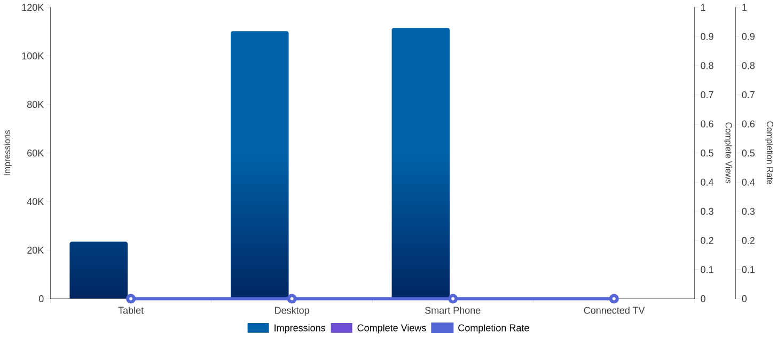
Device Performance
Performance Trends By Device Type
12/16/2025-01/14/2026

Slide 58
Device Performance
Device Performance
Device | Impressions | Complete Views | Completion Rate (Video)
Tablet | 23,487 | 0 | -
Desktop | 110,205 | 0 | -
Smart Phone | 111,560 | 0 | -
Connected TV | 81 | 0 | -
12/16/2025-01/14/2026

